Slide 1




GEOSS Essential Variables
11-12 June 2015, Bari-Italy
Societal Benefit Area: Health
Name: Simon Hales
Institution: World Health Organization
Coordinating an Observation Network of Networks EnCompassing saTellite and IN-situ to fill the Gaps in European Observations
YOUR LOGO

Slide 2

Status of existing EVs in the domain
Is your community developing a set of area-specific essential variables (EV)s?
(yes … but note that “area specific” is not a useful concept in the global health context)
If not, is the community planning to start this in the near future?
  Have you attended previous meeting? No
  Are you considering reference documents from other domains? Yes

Slide 3
The process underlying EV definition
What criteria, methodology, and process should be used to identify EVs?
  Top down: start with health significance
  Describe relevant causal pathways / networks
  Consider how EO can contribute useful information
Do you have a template to document a EV?
  No, but … good examples of earth observation contributing to health planning for extreme climate events, (cyclones, heatwaves, air pollution),
  …Emerging examples for other issues, water, food security, some communicable diseases

Slide 4
Start with public health importance
Global “burden of disease”:
  (biomedical model, focus on downstream “risk factors” = limited usefulness in this context)
  Poor countries: effects of poverty via lack of access to food, water, shelter, clean energy: high mortality rates, low life expectancy, high burden of communicable diseases, unplanned urban settlements = poor infrastructure (WASH, shelter vulnerable to disasters, dirty energy)
  Rich countries: diseases of overconsumption (non communicable disease: cardiovascular diseases, cancers, psychological problems).
Threat to global ecological sustainability is the most important (and relevant) health issue

Slide 5
Gaps and requirements
EVs (from other domains) are more or less relevant to health

Slide 6
Healthy planet, healthy people
Health is an integrating factor
Paradox ~ health is improving (on average)
Prediction: this will not last
Fundamental determinants of health:
  Little to do with health services (the biomedical model is not very useful in this context)
  More to do with long term availability of ecosystem services and the social distribution of health-giving, food, water, shelter, security, (life purpose)

Slide 7
The problem
Meeting current human needs...
… without compromising the health of future generations
We need to live within planetary boundaries
(… and social boundaries)
The most important essential variables for health should be included in “upstream” social benefit areas
BUT the social distribution of positive (health-giving) factors and negative (unhealthy) exposures is not necessarily captured
This requires additional analysis (eg. geographic overlay of physical/earth observation variables with socio-demographic variables)?

Slide 8
Causal pathways
There are examples of direct “toxicological” effects on health
BUT most impacts, including the most important impacts, occur via complex pathways

Slide 9
Mechanisms of health impact
K.R. Hayes et al. / Ecological Indicators 57 (2015) 409–419

Slide 10
Mostly not simple or direct!
Air quality

Slide 11
K.R. Hayes et al. / Ecological Indicators 57 (2015) 409–419
Air quality
climate extremes, heat, UVR, cyclones
(NRT data)

Slide 12
K.R. Hayes et al. / Ecological Indicators 57 (2015) 409–419
Air quality
Social factors
climate extremes, heat, UVR, cyclones
(NRT data)

Slide 13

(long term) ecosystem services:
Productive, recycling and regulating…
food, water

Slide 14

Consumption, population, social distribution of resources

Slide 15
Scenarios of future development (eg. SDGs)
of Indicators: population level
Essential variables:
Weather/climate,
food, water, energy: availability
(transport, housing, waste infrastructure, within and between countries) +distribution (socio-economic data)
Primary observations:
births, deaths, disease patterns

Slide 16

Scenarios of future development
Earth system models
Indicators: eg. proportion of population with “healthy” living conditions
Social system: (migration, conflict, resources)
Observations
of policy and management
Essential variables:
Weather/climate,
food, water, energy: availability
(transport, housing, waste infrastructure, within and between countries) +distribution (socio-economic data)
Ecosystem services
Disciplinary models (eg. air quality)
Primary observations:
births, deaths, disease patterns

Slide 17
Conclusions
Overlapping with EVs in other domains (SBA)
  Yes, very substantially, especially climate, disasters, water, food, energy, biodiversity
Priorities for EVs operational monitoring
  Contribution to understanding and validating assessment models (medium to long term scenarios, rather than short term forecasts)
Recommendations for GEO/GEOSS
  Inform global policy questions about sustainability rather than specific “biomedical” health issues
  Extend engagement with global health community
Future work
  Sustainable development goals, UN conventions (FCCC, CBD) planetary boundaries, safe pathways of development, extreme events, food security, water and sanitation,
  Integration with socio-economic variables (social inequality, population)
  Human impacts on earth system (production, consumption)

Slide 18
Scenarios of future development
Earth system models
Social system: (migration, conflict, resources)
human impacts on earth system
Essential variables:
Weather/climate,
food, water, energy: availability
(transport, housing, waste infrastructure, within and between countries) +distribution (socio-economic data)
Ecosystem services
Primary observations:
births, deaths, disease patterns

Slide 19

The End

Slide 20
“Area specific” EVs for health
Weather/climate, “near real time data”, forecasting of extreme events
Famine early warning
Short term forecasting of communicable diseases (under development, generally not yet operationally useful)

Slide 21
EVs validation and use
To what extent these EVs (if any) are validated and used
  Limited validation and use (as far as I know)
Are the EVs linked to applications and users?
  (not efficiently, see examples)
How is a community agreement reached?
  Not clear (at least, not to me – community is fragmented and not well established)
Is a community review process in place?
  Are the EVs linked to an international body
  Yes (SDGs, Future Earth, CBD, Montreal protocol, UNFCCC, UNEP, UNDP, UNICEF, WMO, WHO, IFRCRCS)
Involved in accepting the EVs?
    Not clear

Slide 22
Describing the monitoring networks currently operational
Do you have a database with information on the EVs?
  No – relevant data are scattered and mostly not linked to health issues (due to complex, indirect causal pathways for the most important impacts)
Do you know network currently operational for medium-term/long-term monitoring?
  All existing networks are potentially relevant
Are the current operational networks operated by your community measuring the EVs?
  Health community relies on other to do this

Slide 23
Assessing EV observational needs and readiness
For some Use Case, have you already focused on EVs’ features:
  Temporal frequency
  Spatial resolution
  Accuracy
  etc.
  Yes, (example of air pollution, others below)
Challenges and how these are addressed (if any)
  Thinking in terms of global sustainability, not biomedical effects

Slide 24
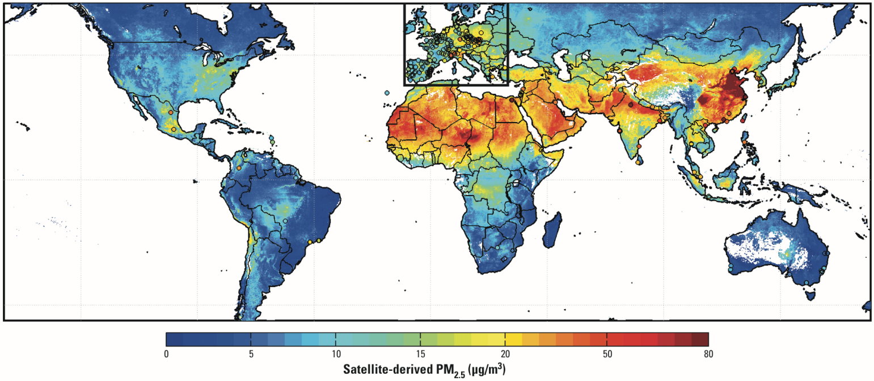
Example direct health effect
Long term (multi-annual) average ambient fine particle concentration at the surface
  Method: remote sensing plus atmospheric model plus epidemiological model
Global Estimates of Ambient Fine Particulate Matter Concentrations from Satellite-Based Aerosol Optical Depth: Development and Application
Aaron van Donkelaar et al, http://ehp.niehs.nih.gov/0901623/

Slide 25
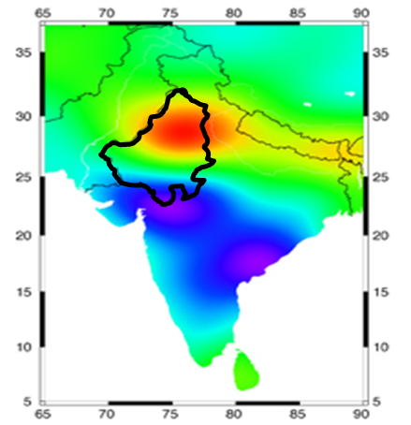
EO can provide water storage in groundwater and surface stores (lakes) and measures of wetland and ecosystem extent

Slide 28
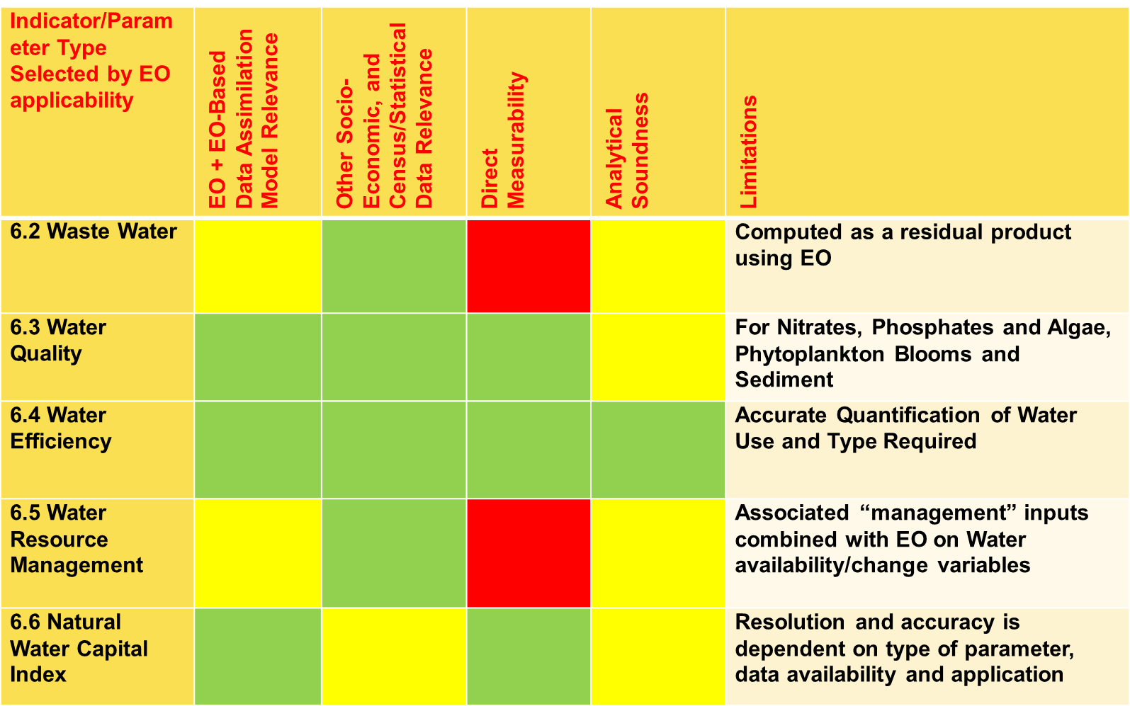

Slide 29
http://apps.who.int/iris/bitstream/10665/174012/1/9789241508537_eng.pdf?ua=1

